Slide 1


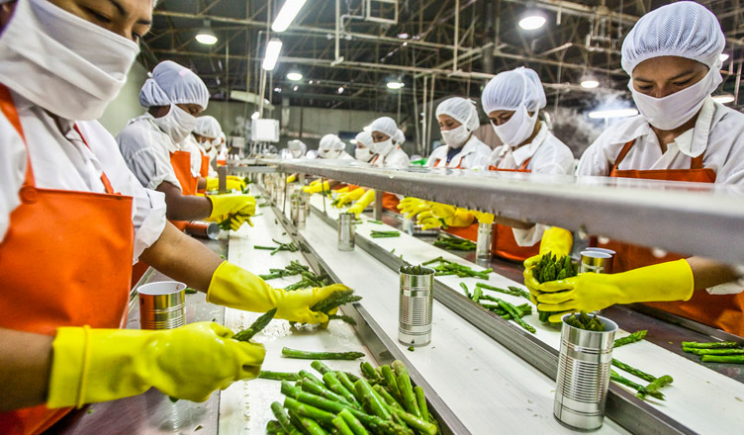
Scheme for Formalisation of Micro food processing Enterprises (FME)
Format of Guidelines

Slide 2
Structure of Guidelines
Cluster Approach – One District One Product
Programme Components
  Support to individual units and Groups
  Branding & Marketing
  Strengthening Institutional Support
Institutional Architecture
  National level
  State level
  District Level
Studies
Capacity Building & Research
Disbursement of Funds
Selection process of units
MIS
Procedure with bank for grants
Steps to be taken by the States

Slide 3
Cluster Approach
One District One Product (ODOP)
States to identify ODOP
Support under the scheme would predominantly would be given for ODOP products for
  Subsidy for capital investment by individual units & groups
  Marketing & Branding
  Common Infrastructure
    by FPOs/SHGs/cooperatives or by state agencies or private

Slide 4
Programme Components
  Individual Units – Credit linked Grant of 35% with max of Rs 10 lakh
  Groups
    FPOs/SHGs/Cooperatives – Credit linked Grant 35% for capital investment, training support, marketing;
    SHGs – Seed capital of Rs 40,000 per member at SHG Federation level
  Common Infrastructure
    Common processing centers, labs, incubation center, warehouse, cold storage, etc.
    Credit linked Grant 35%
  Support for Marketing & Branding

Slide 5
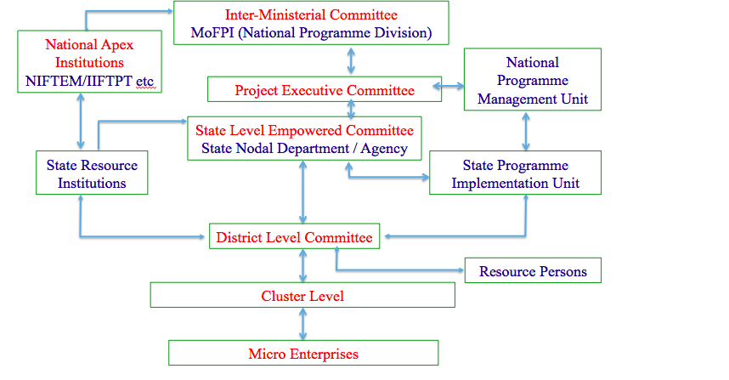
Institutional Architecture

Slide 6
Institutional Architecture - MOFPI
Inter-Ministerial Empowered Committee (IMEC)
  Chaired by Minister for MOFPI
  To approve PIP of the states
  Scheme Guidelines
  PIP for Capacity Building & Research
  Approval of Projects above Rs 10 lakh
Project Executive Committee
  Chaired by Project Director
  Expenditure by GOI up to Rs 10 lakh
  Executive level decisions
NPMU in MOFPI

Slide 7
Institutional Architecture - States
State Level Approval committee
  Chaired by CS
  To recommend to GoI PIP, projects above Rs 10 lakh
  Approve expenditure up to Rs 10 lakh
State Nodal Dept. and State Nodal Agency - SPMU
District level Committee
  Chaired by Collector
  Approval of individual beneficiaries
  Recommend common infrastructure proposals
District Resource Persons
  To be paid Rs 20,000 per beneficiary loan sanctioned

Slide 8
Capacity Building & Research
These components to be 100% funded by GOI
Support to National Level Institutions
  NIFTEM & IIFPT
  Grant for training material, TOT, audio visual support, state centers, standard DPRs, standard machinery development, product development, etc.
  Institutions to prepare PIP
  PMU at NIFTEM & IIFPT
Support to State Level Technical institutions
  State institutions to coordinate training, technical support, product development, packaging, machinery, etc.
  Propose PIP
Committee for Capacity Building & Research in MOFPI
  To examine PIPs
  Coordinate & monitor capacity building & research

Slide 9
State Action
Decide on State Nodal Dept & SNA – 30 June 2020
Set up SLAC – 31 July 2020
Hiring SPMU – 31 Aug 2020
Setting up DLC – 31 July 2020
Engaging District Resource Persons (DRPs) – 31 Aug 2020
Nominate State Level Technical Institution – 31 July 2020
Create Budget Head for the Scheme –First Supplementary Budget
Studies
  Identification of ODOP – 31 July 2020
  State Level Upgradation Plan (SLUP) – 31 Dec 2020

Slide 10
State Action - 2
Selection of Beneficiaries
  Identification of clusters by SLUP
  Applications to be invited
  Identification of potential beneficiaries by DRPs based on clusters
  Sub-committee of DLC to appraise & interview
  Preparation of DPRs - To recommend the cases to banks
  Training, handholding support
DPR to be prepared & recommended by SLAC to MOFPI for funding for groups, common infrastructure and marketing & branding

Slide 11
MOFPI
Nodal Bank
MIS - Entire operations of the scheme to be on MIS
  Application by beneficiaries, its processing, training support to units
  PIP approval
  Submission of all proposals for groups, common infrastructure and their approval by state and MOFPI
  Release of grant, UC
  Monitoring of Scheme
Partner Institutions at National Level – TRIFED, NSCFDC, NCDC, SFAC, NRLM
Empanelment of Institutions for hiring by states

Slide 12
Funding
Items 100% funded by MOFPI
  Capacity Building & research
  Support to National level and state level institutions for capacity building and technical support
  Admn cost at national level and NPMU
  Promotional activities at National level
  Any other item spent directly by GOI
60% share of center for subsidy to be given directly to beneficiary a/c in bank
Rest of the items to be released to the states in 60:40 ratio
First year entire expenditure to be met by GOI to be adjusted in 60:40 ratio with states in next 4 years

Slide 13

Thank You

